Slide 1
Module 12

Slide 2

What is a nerve?

Slide 3
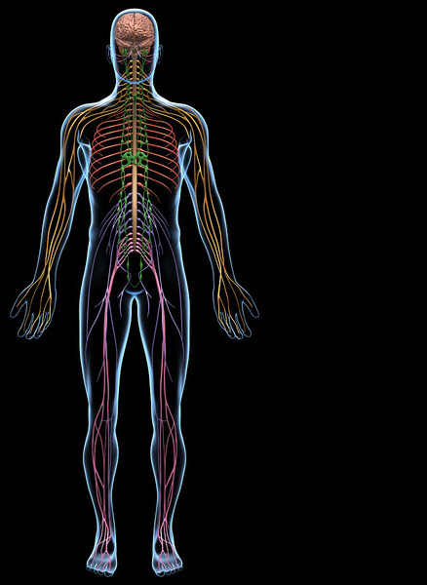
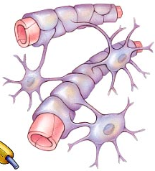
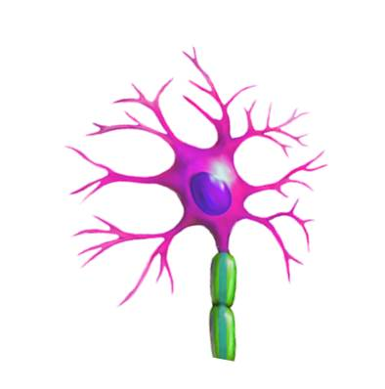
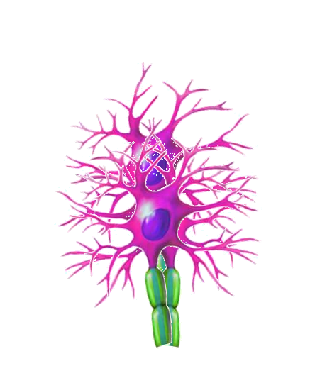
Tissues are composed of cells.
Nerve is a tissue.
Neurons
Neuroglia
Neurons are specialized cells capable of creating and transmitting electro-chemical impulses
Nerve tissue is composed of special cells called as Neurons.
and supportive cells called as Neuroglia.
Neuroglia are supportive cells which assist neurons in there function.

Slide 4
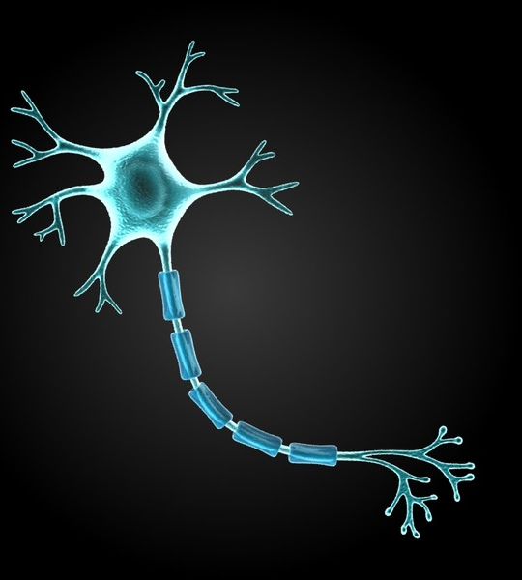
Structure of neuron consists of :
Branches arising from the cyton are called as
Dendrites
Cell body consists of
Nucleus
The long process arising from the cyton is called as
The central cell body called as
Cyton
Axon
Nerve endings
Processes arising from the axon are called as

Slide 5
Thank You

